Slide 1
MILE STONE PROJECT
SALARY SURVEY ANALYSIS ON 2021

Slide 2
SUMMARY
Analysed the salary survey for year 2021
Scrubbed the data into cleaned data set
Queried the cleaned data in SQL to create a dash board
Prompt the dash board to visualize the salary survey trends

Slide 3
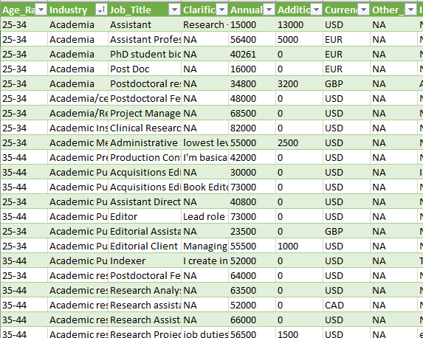
DATA CLEANING
Remove unnecessary values.
Remove duplicate data.
Avoid typos.
Convert data types.
Search for missing values.
Use a clear format.

Slide 4
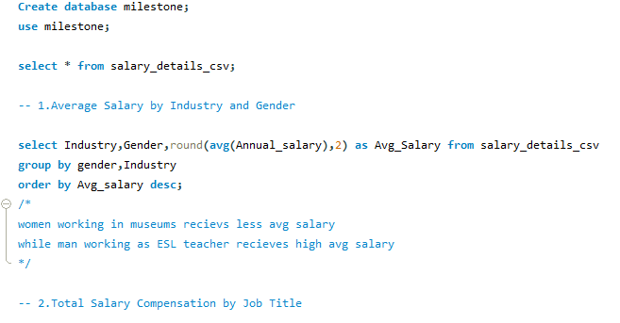
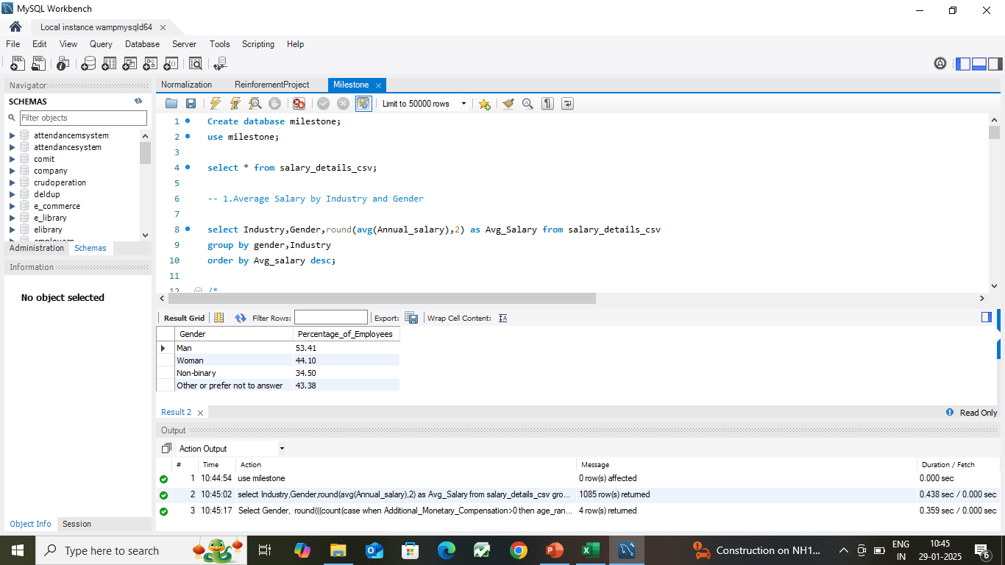
DATA QUERY
Transferred the cleaned data into My
Applied some Queries required for dashboards.
Exported into Excel files.

Slide 5
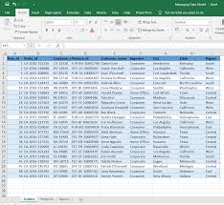
DATA MODELLING
After exporting, the tables save all the sheets in single workbook.
Added tables to data model in Power Pivot.
Created relations(connections) across Tables.

Slide 6
Charts
Created Pivot Tables and charts.
Added Slicers.
Implemented KPI’s.

Slide 7
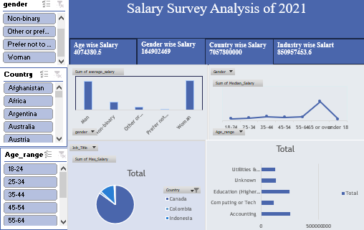
DASH BOARD

Slide 8
CONCLUSION AND RECOMMENDATION
Canada country has 1st place to pay the high salary
In Gender wise salary pay is Men is got high pay
Low salary pay for Women and Non-Binary
Focused on Accounting industry to Gain a high salary

Slide 9
Thank you

